Slide 1

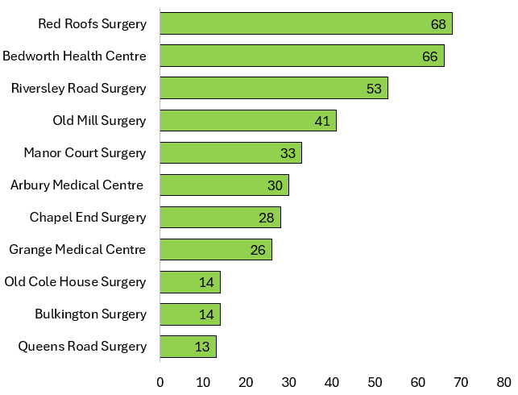
SPLW Referrals Quarter 2 - 2026/2027
Practice Name | No. Referrals | Referral Percentage | Representative Percentage
Red Roofs Surgery | 68 | 17.62% | 12.80%
Bedworth Health Centre | 66 | 17.10% | 20.76%
Riversley Road Surgery | 53 | 13.73% | 6.99%
Old Mill Surgery | 41 | 10.62% | 13.09%
Manor Court Surgery | 33 | 8.55% | 8.23%
Arbury Medical Centre | 30 | 7.77% | 9.42%
Chapel End Surgery | 28 | 7.25% | 4.94%
Grange Medical Centre | 26 | 6.74% | 11.58%
Bulkington Surgery | 14 | 3.63% | 5.94%
Old Cole House Surgery | 14 | 3.63% | 3.62%
Queens Road Surgery | 13 | 3.37% | 2.63%
SPLW Referrals – Total 386
GP Surgery
Number of Referrals
The number of incoming referrals were impacted between the 31st July and the 1st October due to the transition from JOY to Riviam,
as the team were not dealing with new referrals during the transition period .

Slide 2
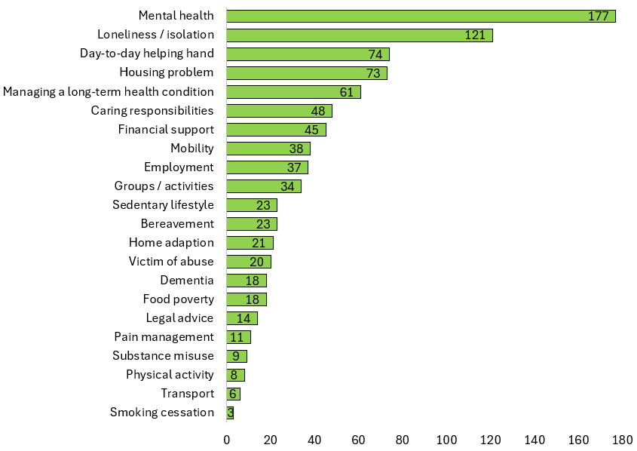
SPLW Top Referral Reasons Quarter 2 - 2026/2027
SPLW Top Referral Reasons
Reason for Referral | Number | Percentage
Mental health | 177 | 20.07%
Loneliness / isolation | 121 | 13.72%
Day-to-day helping hand | 74 | 8.39%
Housing problem | 73 | 8.28%
Managing a long-term health condition | 61 | 6.92%
Caring responsibilities | 48 | 5.44%
Financial support | 45 | 5.10%
Mobility | 38 | 4.31%
Employment | 37 | 4.20%
Groups / activities | 34 | 3.85%
Bereavement | 23 | 2.61%
Sedentary lifestyle | 23 | 2.61%
Home adaption | 21 | 2.38%
Victim of abuse | 20 | 2.27%
Food poverty | 18 | 2.04%
Dementia | 18 | 2.04%
Legal advice | 14 | 1.59%
Pain management | 11 | 1.25%
Substance misuse | 9 | 1.02%
Physical activity | 8 | 0.91%
Transport | 6 | 0.68%
Smoking cessation | 3 | 0.34%
SPLW Top Referral Reasons
Referral Reason
Number of Referrals

Slide 3
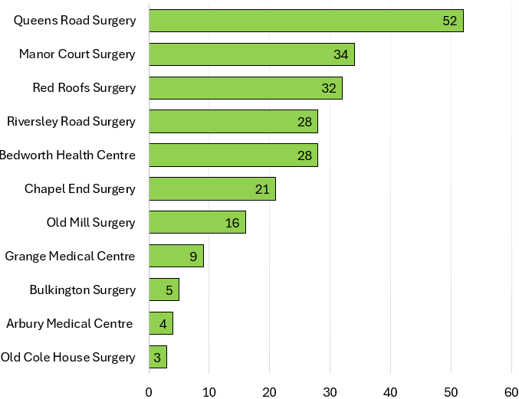
HWBC Referrals Quarter 2 - 2026/2027
Practice Name | No. Referrals | Referral Percentage | Representative Percentage
Queens Road Surgery | 52 | 22.41% | 2.63%
Manor Court Surgery | 34 | 14.66% | 8.23%
Red Roofs Surgery | 32 | 13.79% | 12.80%
Bedworth Health Centre | 28 | 12.07% | 20.76%
Riversley Road Surgery | 28 | 12.07% | 6.99%
Chapel End Surgery | 21 | 9.05% | 4.94%
Old Mill Surgery | 16 | 6.90% | 13.09%
Grange Medical Centre | 9 | 3.88% | 11.58%
Bulkington Surgery | 5 | 2.16% | 5.94%
Arbury Medical Centre | 4 | 1.72% | 9.42%
Old Cole House Surgery | 3 | 1.29% | 3.62%
HWBC Referrals – Total 232
GP Surgery
Number of Referrals

Slide 4
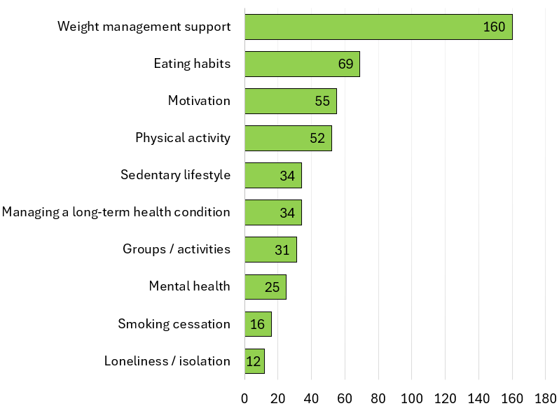
HWBC Top Referral Reasons Quarter 2 - 2026/2027
HWBC Top Referral Reasons
Reason for Referral | Number | Percentage
Weight management support | 160 | 32.79%
Eating habits | 69 | 14.14%
Motivation | 55 | 11.27%
Physical activity | 52 | 10.66%
Managing a long-term health condition | 34 | 6.97%
Sedentary lifestyle | 34 | 6.97%
Groups / activities | 31 | 6.35%
Mental health | 25 | 5.12%
Smoking cessation | 16 | 3.28%
Loneliness / isolation | 12 | 2.46%
HWBC Top Referral Reasons
Referral Reason
Number of Referrals

Slide 5
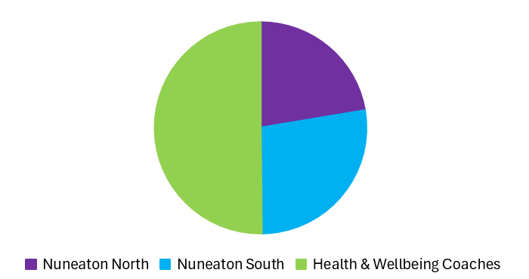
Current Waiting Lists
Nuneaton North | 53
Nuneaton South | 73
Health & Wellbeing Coaches | 157
Due to the implementation of Riviam, referrals from were not dealt with by the Social Prescribing and Health & Wellbeing coach teams from the 31st July until the 1st October.

Slide 6
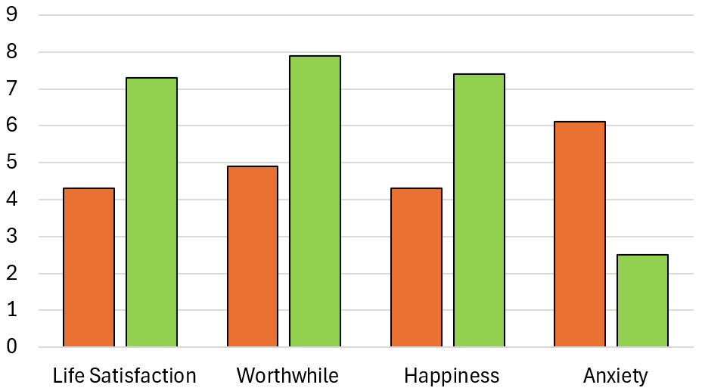
SPLW & HWBC ONS4 Average Improvement Scores Quarter 2 - 2026/2027
Average Improvement in Wellbeing Based on ONS4
 | Average Baseline | Average Follow Up | % Average Improvement
Life Satisfaction | 4.3 | 7.3 | 69.8%
Worthwhile | 4.9 | 7.9 | 61.2%
Happiness | 4.3 | 7.4 | 72.1%
Anxiety | 6.1 | 2.5 | 50%
Average Score
Overall Average Improvement in Wellbeing
65.5%
Wellbeing Questions
*Anxiety scoring is inverted with a lower score indicating an improvement.
These improvement scores are based on 4 questions which are scored from 1 – 10 which are asked at the initial assessment and upon discharge.
1. Overall, how satisfied are you with your life nowadays?
2. Overall, to what extent do you feel the things you do in your life are worthwhile?
3. Overall, how happy did you feel yesterday?
4. On a scale where 0 is “not at all anxious” and 10 is “completely anxious”, overall,
how anxious did you feel yesterday?

Slide 7
Feedback from our Partners, Patients and Groups…
“Before I got referred to you I felt lost, was lost in guilt, weight was gained from a lot of different emotions and then you helped me, guided me, taught me new traits I use to this day and encouraged me to try new things like going back to the gym. I’m so pumped and ready for Sunday for my gym session, I just want to say thank you from the bottom of my heart for all u have done for me.
“You have been really supportive and encouraging, it has helped me achieve my goal of walking 3 kilometers on my treadmill in 50 minutes which I now do 6 days a week thank you so much”
“Thank you so much for the help and support you’ve provided to dad and the assistance you gave me with applying for the NHS funding.
You can’t imagine what a massive weight this is off our minds to know he has been accepted for the funding for care”
“Thank you for everything you have done for me, you had supported me the first time a few years ago and your support was valuable. And you’ve supported me again. I am grateful for your service and I’m sure other people find it just as valuable. How much you’ve done for me, and all the work that you do for me and other people is amazing. There is no way I could repay for you”
Daughter of Mr A, 76
Miss E, 53
Mrs B, 56
Mr F, 66
“Sometimes it was difficult to talk as it opens things up, other times I needed to express how I feel and talk. I appreciate the support, you helping me, calling me and listening.”
“I’ve now lost 1 stone 10 pounds and everyone is complimenting me. I’m exercising regularly and using My Fitness Pal. My blood pressure has also reduced. I have a review with the GP about potentially reducing my blood pressure medication."
“Thank you so much for letting me shadow you yesterday. I appreciated how lovely, kind, and supportive you were throughout with me and your patient.
I learnt a lot and really enjoyed my time with you.
Thank you once again for making it a lovely learning experience😊”
Mrs C, 35
Mr D, 41
Stroke Rehab Assistant

Slide 8
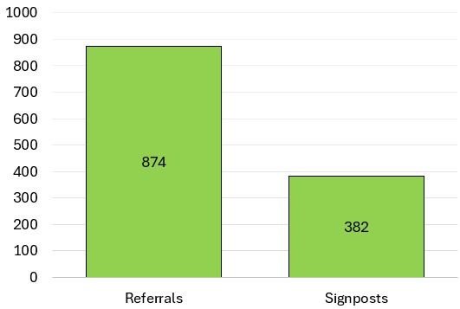
Top 25 Services Referred to by SPLW’s / HWBC’s in Quarter 2 - 2026/2027
Service | Total
Citizens Advice Bureau | 89
Nuneaton & Bedworth PCN Care Coordinators | 44
P3 Warwickshire | 41
Nuneaton & Bedworth PCN Mental Health Practitioners | 35
Age UK Coventry and Warwickshire | 32
Warwickshire County Council - Adult Social Care | 32
Nuneaton & Bedworth PCN Walk and Talk | 30
KeyRing | 29
Nuneaton & Bedworth PCN Dieticians | 29
Nuneaton & Bedworth PCN Seated Exercise Class | 28
Talking Therapies Coventry & Warwickshire | 27
ISPA Adult out of Hospital Services | 25
Family Information Service (FIS) | 23
Pure Physiotherapy Pain Management | 22
Recovery & Wellbeing Academy | 21
HEART N&B Borough Council | 20
Mental Health Access Hub | 19
Turning Point Warwickshire | 19
Nuneaton & Bedworth PCN Fit for Life | 18
Trussell Trust | 17
Nuneaton & Bedworth PCN Health and Wellbeing Coaches | 16
Volunteer Friends | 16
Nuneaton & Bedworth PCN GP Services | 16
WorkWell Warwickshire - WorkWell Coventry & Warwickshire | 16
Community Autism Support Service (CASS) | 15
Total Number of Referrals / Signposts made to Community / Statutory Services by SPLW’s / HWBC’s During Interventions
Number of Referrals / Signposts
Signposts are made when either there is no referral process for a service or it is felt appropriate to empower a patient who is sufficiently able to make contact with a service themselves .

