Slide 1

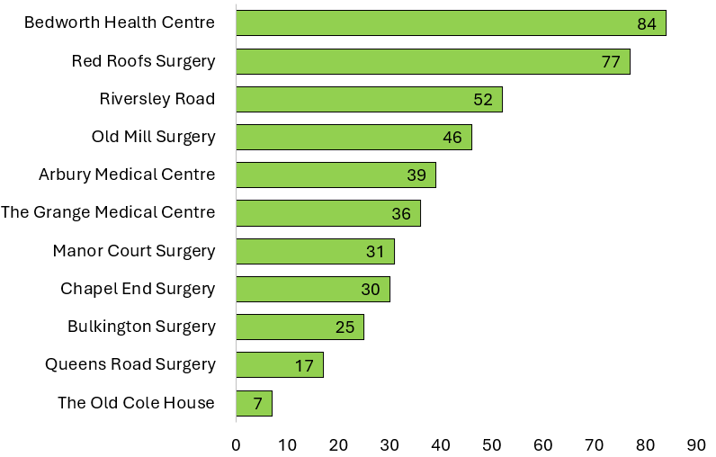
SPLW Referrals Quarter 4 - 2025/2026
Practice Name | No. Referrals | Referral Percentage | Representative Percentage
Bedworth Health Centre | 84 | 18.92% | 20.79%
Red Roofs Surgery | 77 | 17.34% | 13.19%
Riversley Road | 52 | 11.71% | 6.61%
Old Mill Surgery | 46 | 10.36% | 13.10%
Arbury Medical Centre | 39 | 8.78% | 9.49%
The Grange Medical Centre | 36 | 8.11% | 11.79%
Manor Court Surgery | 31 | 6.98% | 8.15%
Chapel End Surgery | 30 | 6.76% | 4.81%
Bulkington Surgery | 25 | 5.63% | 5.71%
Queens Road Surgery | 17 | 3.83% | 2.67%
The Old Cole House | 7 | 1.58% | 3.68%
SPLW Referrals – Total 444
GP Surgery
Number of Referrals

Slide 2
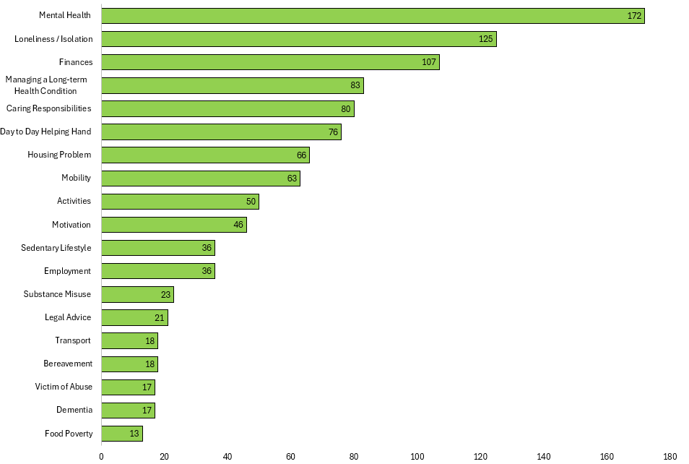
SPLW Top Referral Reasons Quarter 4 - 2025/2026
SPLW Top Referral Reasons
Reasons for Referral | Number | Percentage
Mental Health | 172 | 16.12%
Loneliness / Isolation | 125 | 11.72%
Finances | 107 | 10.03%
Managing a Long-term Health Condition | 83 | 7.78%
Caring Responsibilities | 80 | 7.50%
Day to Day Helping Hand | 76 | 7.12%
Housing Problem | 66 | 6.19%
Mobility | 63 | 5.90%
Activities | 50 | 4.69%
Motivation | 46 | 4.31%
Employment | 36 | 3.37%
Sedentary Lifestyle | 36 | 3.37%
Substance Misuse | 23 | 2.16%
Legal Advice | 21 | 1.97%
Bereavement | 18 | 1.69%
Transport | 18 | 1.69%
Dementia | 17 | 1.59%
Victim of Abuse | 17 | 1.59%
Food Poverty | 13 | 1.22%
SPLW Top Referral Reasons
Referral Reason
Number of Referrals

Slide 3
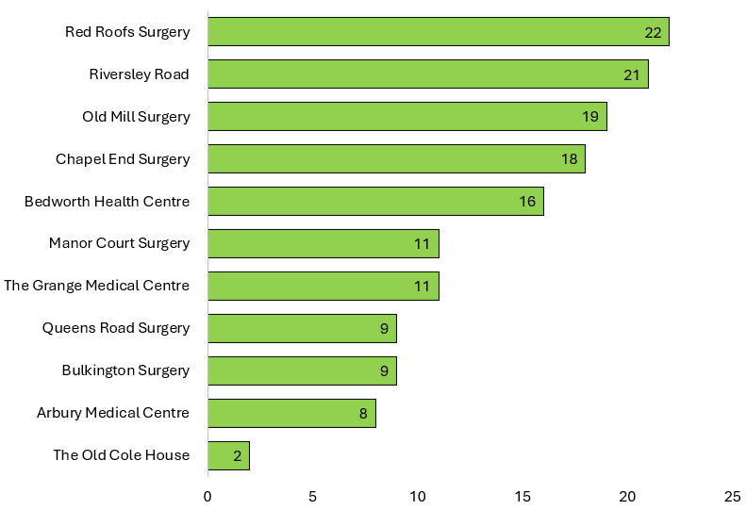
HWBC Referrals Quarter 4 - 2025/2026
Practice Name | No. Referrals | Referral Percentage | Representative Percentage
Red Roofs Surgery | 22 | 15.07% | 13.19%
Riversley Road | 21 | 14.38% | 6.61%
Old Mill Surgery | 19 | 13.01% | 13.10%
Chapel End Surgery | 18 | 12.33% | 4.81%
Bedworth Health Centre | 16 | 10.96% | 20.79%
The Grange Medical Centre | 11 | 7.53% | 11.79%
Manor Court Surgery | 11 | 7.53% | 8.15%
Bulkington Surgery | 9 | 6.16% | 5.71%
Queens Road Surgery | 9 | 6.16% | 2.67%
Arbury Medical Centre | 8 | 5.48% | 9.49%
The Old Cole House | 2 | 1.37% | 3.68%
HWBC Referrals – Total 146
GP Surgery
Number of Referrals

Slide 4
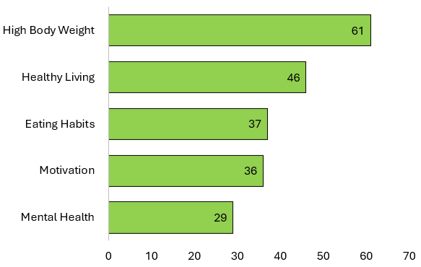
HWBC Top Referral Reasons Quarter 4 - 2025/2026
HWBC Top Referral Reasons
Reasons for Referral | Number | Percentage
High Body Weight | 61 | 29.19%
Healthy Living | 46 | 22.01%
Eating Habits | 37 | 17.70%
Motivation | 36 | 17.22%
Mental Health | 29 | 13.88%
HWBC Top Referral Reasons
Referral Reason
Number of Referrals

Slide 5
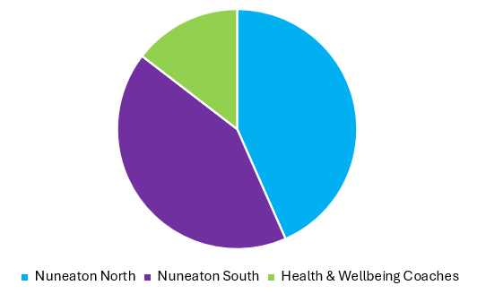
Current Waiting Lists
Nuneaton North | 128
Nuneaton South | 124
Health & Wellbeing Coaches | 43

Slide 6
Feedback from our Partners, Patients and Groups…
I was apprehensive about a referral to the Health and Wellbeing coach, but this service has been amazing. I can’t believe the difference in me from 6 months ago and everyone is noticing it. Not only in personality but I have even started to lose so much weight as my confidence and mindset has changed.
I feel the setting goals have really helped and has given me a focus. I know that every call I then could talk about them and how well I had done and this helped so much!
I’m now going to the gym and enjoying it and I’m even joining classes! I have even bought weights to do exercises at home when I can’t make the gym or if I know it will be a busy day! My mindset has completely changed with everything. I’m now enjoying my job so much more and I just feel physically and mentally so much stronger than I did 6 months ago. I don’t fear the future as much as I did with my anxiety. Thank you so much for all your help and support.
Feel that everyone should have this service. You were such a great help with putting me in touch with CAB etc. I would never of known what to do"
I was a couch potato before. I didn't do anything. Now I absolutely love the Seated Exercise class. Doing things, I never thought I would. It's fun and love the Social. You have helped me so much. I didn't know that anything like this service existed, and didn't know what to expect, but it's great”
Miss A, 29
Mrs B, 66
Hi, I would like to take this time to send feedback for the services and care we have received from you. From the moment we initially spoke to you, you have been an absolute source of knowledge, relief and support and have gone above and beyond at every level. It has been really hard for us looking after our mother in law following a bad fall and an alzhiemers diagnosis and you have given us so much support. Knowing what is available, what we can do to help and sometimes just listening through my frustrations. Thank you so much for the bottom of my heart...
I just wanted to say a big thank you, you have been amazing! I have been on the sick from work due to family stress, you were there at the end of the phone to listen and offer support. Your kind, calm, understanding approach has allowed me to open up about my feelings and realise the importance of self care. I do not think you are aware of how grateful I am for the weekly phone calls, check in’s and endless support. Everyone should be made aware of this amazing service that you offer. I am now back in work, ensuring I have self care and ‘me’ time regularly, joining in with Sky Blues and awaiting a gym subscription. I would highly recommend this service to anyone who just needs that extra support to improve their mental health and wellbeing. I cannot thank you enough, you have made such a difference to me and my family. Thank you :)
Mrs C, 81
Mrs D, 54

Slide 7
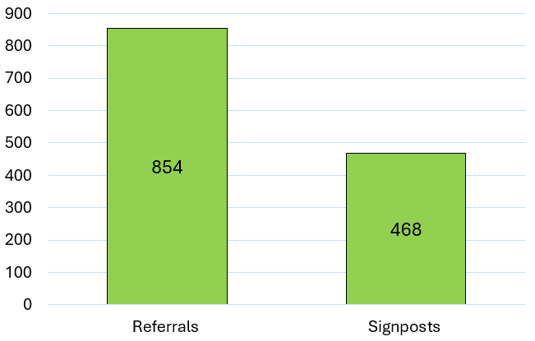
Top 25 Services Referred to by SPLW’s / HWBC’s in Quarter 4 - 2025/2026
Service | Total
Citizens Advice Bureau & Law Centre - Health Justice Partnership Programme | 120
N&B PCN Seated Exercise Class | 55
N&B PCN Mental Health Practitioners | 49
Warwickshire County Council - Adult Social Care | 49
Talking Therapies Coventry and Warwickshire | 48
Volunteer Friends | 45
N&B PCN Walk and Talk | 42
Pure Physiotherapy - Pain Management | 39
Mind - Coventry and Warwickshire | 39
Active Sky Blues 12 Week Programme | 34
P3 | 28
HEART - N&B Borough Council | 28
ISPA - Adult out of Hospital Services | 25
N&B PCN Dieticians | 23
GP Services - Nuneaton and Bedworth | 22
WorkWell Coventry & Warwickshire | 18
N&B PCN Health & Wellbeing Coaches | 18
KeyRing | 18
Carers Trust Warwickshire | 17
Everyone Active | 17
Mental Health Access Hub | 16
Recovery and Wellbeing Academy | 16
N&B PCN Pain Café | 15
The Trussell Trust - Food Bank | 15
Fitter Futures - Stop Smoking | 13
Total Number of Referrals / Signposts made to Community / Statutory Services by SPLW’s / HWBC’s During Interventions
Number of Referrals / Signposts
Signposts are made when either there is no referral process for a service or it is felt appropriate to empower a patient who is sufficiently able to make contact with a service themselves .

