Slide 1

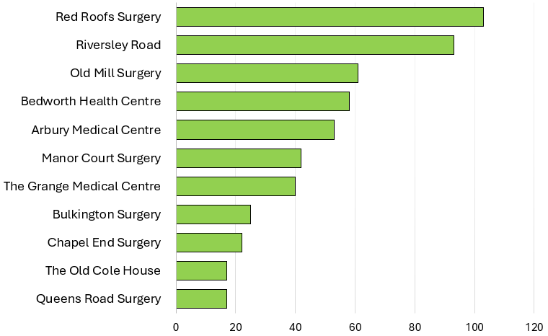
SPLW Referrals Quarter 2 - 2025/2026
Practice Name | No. Referrals | Referral Percentage | Representative Percentage
Red Roofs Surgery | 103 | 19.40% | 13.19%
Riversley Road | 93 | 17.51% | 6.61%
Old Mill Surgery | 61 | 11.49% | 13.10%
Bedworth Health Centre | 58 | 10.92% | 20.79%
Arbury Medical Centre | 53 | 9.98% | 9.49%
Manor Court Surgery | 42 | 7.91% | 8.15%
The Grange Medical Centre | 40 | 7.53% | 11.79%
Bulkington Surgery | 25 | 4.71% | 5.71%
Chapel End Surgery | 22 | 4.14% | 4.81%
Queens Road Surgery | 17 | 3.20% | 2.67%
The Old Cole House | 17 | 3.20% | 3.68%
SPLW Referrals – Total 531
GP Surgery
Number of Referrals

Slide 2
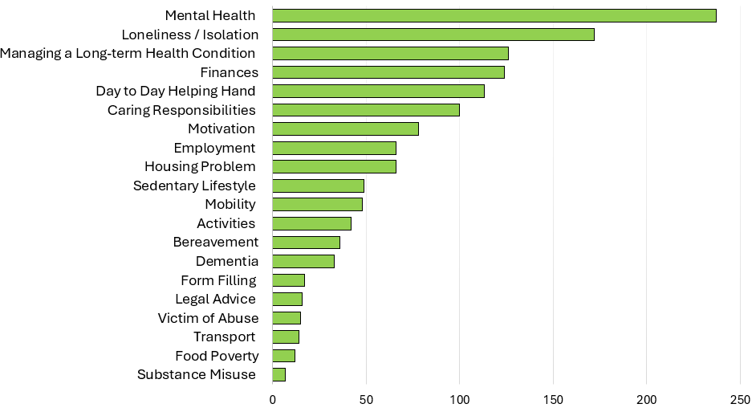
SPLW Top Referral Reasons Quarter 2 - 2025/2026
SPLW Top Referral Reasons
Reasons for Referral | Number | Percentage
Mental Health | 237 | 17.29%
Loneliness / Isolation | 172 | 12.55%
Managing a Long-term Health Condition | 126 | 9.19%
Finances | 124 | 9.04%
Day to Day Helping Hand | 113 | 8.24%
Caring Responsibilities | 100 | 7.29%
Motivation | 78 | 5.69%
Housing Problem | 66 | 4.81%
Employment | 66 | 4.81%
Sedentary Lifestyle | 49 | 3.57%
Mobility | 48 | 3.50%
Activities | 42 | 3.06%
Bereavement | 36 | 2.63%
Dementia | 33 | 2.41%
Benefits Advice | 17 | 1.24%
Legal Advice | 16 | 1.17%
Victim of Abuse | 15 | 1.09%
Transport | 14 | 1.02%
Food Poverty | 12 | 0.88%
Substance Misuse | 7 | 0.51%
SPLW Top Referral Reasons
Referral Reason
Number of Referrals

Slide 3
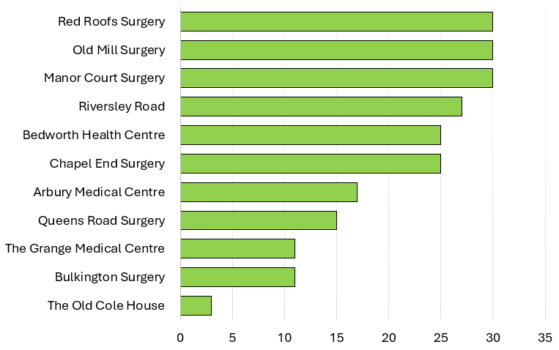
HWBC Referrals Quarter 2 - 2025/2026
Practice Name | No. Referrals | Referral Percentage | Representative Percentage
Manor Court Surgery | 30 | 13.39% | 8.15%
Old Mill Surgery | 30 | 13.39% | 13.10%
Red Roofs Surgery | 30 | 13.39% | 13.19%
Riversley Road | 27 | 12.05% | 6.61%
Chapel End Surgery | 25 | 11.16% | 4.81%
Bedworth Health Centre | 25 | 11.16% | 20.79%
Arbury Medical Centre | 17 | 7.59% | 9.49%
Queens Road Surgery | 15 | 6.70% | 2.67%
Bulkington Surgery | 11 | 4.91% | 5.71%
The Grange Medical Centre | 11 | 4.91% | 11.79%
The Old Cole House | 3 | 1.34% | 3.68%
HWBC Referrals – Total 224
GP Surgery
Number of Referrals

Slide 4
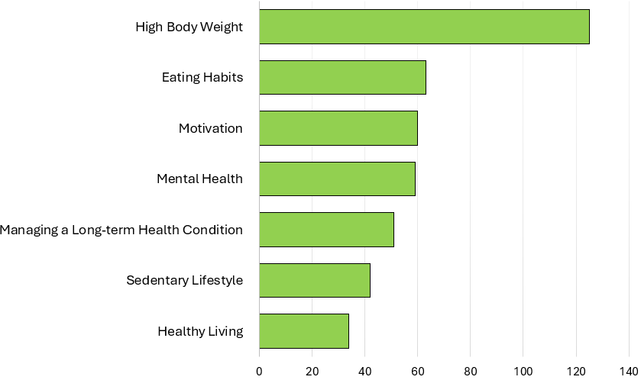
HWBC Top Referral Reasons Quarter 2 - 2025/2026
HWBC Top Referral Reasons
Reasons for Referral | Number | Percentage
High Body Weight | 125 | 28.80%
Eating Habits | 63 | 14.52%
Motivation | 60 | 13.82%
Mental Health | 59 | 13.59%
Managing a Long-term Health Condition | 51 | 11.75%
Sedentary Lifestyle | 42 | 9.68%
Healthy Living | 34 | 7.83%
HWBC Top Referral Reasons
Referral Reason
Number of Referrals

Slide 5
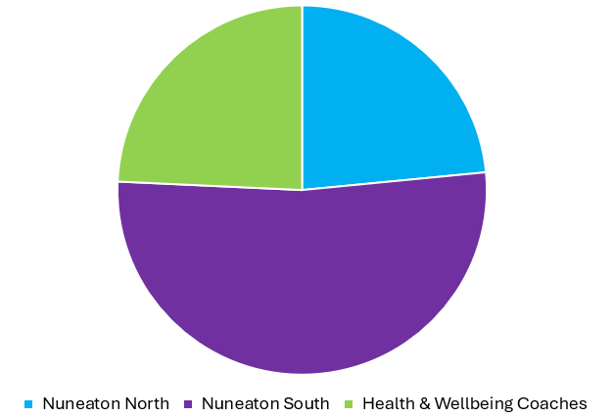
Current Waiting Lists
Nuneaton North | 88
Nuneaton South | 196
Health & Wellbeing Coaches | 91

Slide 6
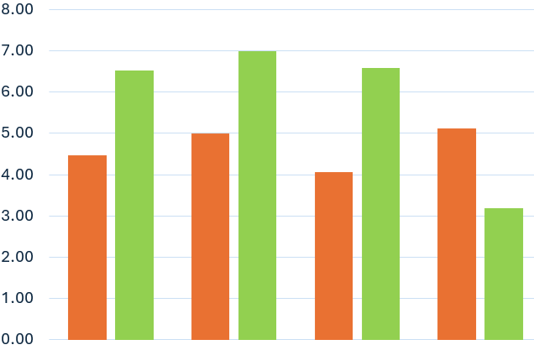
SPLW & HWBC ONS4 Average Improvement Scores Quarter 2 - 2025/2026
Average Improvement in Wellbeing Based on ONS4
 | Average Baseline | Average Follow Up | % Average Improvement
Life Satisfaction | 4.47 | 6.53 | 46%
Worthwhile | 5.00 | 7.00 | 40%
Happiness | 4.06 | 6.59 | 62%
Anxiety | 5.12 | 3.18 | 38%
Average Score
Life Satisfaction
Worthwhile
Happiness
Anxiety
Overall Average Improvement in Wellbeing
46.5%
Wellbeing Questions
*Anxiety scoring is inverted with a lower score indicating an improvement.
These improvement scores are based on 4 questions which are scored from 1 – 10 which are asked at the initial assessment and upon discharge.
1. Overall, how satisfied are you with your life nowadays?
2. Overall, to what extent do you feel the things you do in your life are worthwhile?
3. Overall, how happy did you feel yesterday?
4. On a scale where 0 is “not at all anxious” and 10 is “completely anxious”, overall,
how anxious did you feel yesterday?

Slide 7
Feedback from our Partners, Patients and Groups…
“When I first started, I was very anxious, stressed and very overweight. I was eating the wrong foods and wasn’t exercising, I even ended up in A and E because my blood pressure was dangerously high.
I have completely changed how I eat and I am eating heathier, cooked meals, no junk food and have even started at the gym regularly.
My blood pressure is now down to a normal range and I’m very pleased to tell you I’m now 5 stone and 2 pounds lower in weight and I am still losing!!!
I’ve gained confidence in myself and have entered the London Marathon for next April to raise money for the Salvation Army!
I feel in control of my mental health and my anxiety is at bay.
I can’t thankyou enough for all your support and motivation!”
“I feel that everyone should have this service. The Social Prescriber was such a great help, putting me in touch with CAB etc. I would never have known what to do.
I was a couch potato before, I didn't do anything! Now I absolutely love the Seated Exercise class and doing things I never thought I would. It's fun and I love the Social side of it and seeing the staff every other week.
You have helped me so much, I didn't know that anything like this service existed, and didn't know what to expect, but it's great."
Mrs B, 65
“I’d just like to take a moment to say thank you to you and your team, I understand only too well the constraints of time and bodies.
Your service has become an incredible gateway for us, quite often we are unable to access the appropriate services due to lack of information however, joint working has proven to facilitate some excellent results!
I believe social prescribers are an incredible thread that indeed holds everything together, so thank you.”
Mr H, 48
Sioux, The Makery

Slide 8
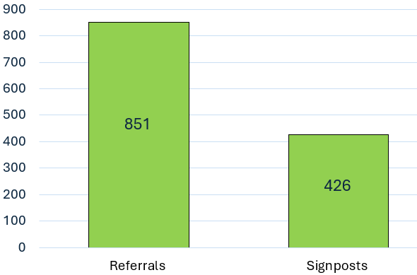
Top 30 Services Referred to by SPLW’s / HWBC’s in Quarter 2 - 2025/2026
Service Name | Number of Referrals
Citizens Advice Bureau | 125
Volunteer Friends | 51
N&B PCN Walk and Talk | 48
Warwickshire County Council - Adult Social Care | 47
WorkWell Coventry & Warwickshire | 44
N&B PCN Mental Health Link Workers | 41
N&B PCN Seated Exercise Class | 40
Active Sky Blues 12 week programme | 36
HEART - N&B Borough Council | 31
Pure Physiotherapy - Pain Management | 29
P3 | 29
Talking Therapies Coventry and Warwickshire | 27
N&B PCN Dietician | 25
N&B PCN - Pain Cafe | 23
ISPA | 22
N&B PCN - Walking Football | 21
Everyone Active | 18
Carers Trust | 18
KeyRing | 17
Caring Together Warwickshire | 15
N&B PCN Health & Wellbeing Coaches | 15
Mind - Coventry and Warwickshire | 14
The Trussell Trust - Food Bank | 14
Mental Health Access Hub | 13
Christians Against Poverty CAP | 13
Age Uk Coventry and Warwickshire | 13
Act on Energy | 12
Sleep Station | 12
Family Information Service Warwickshire | 11
Total Number of Referrals / Signposts made to Community / Statutory Services by SPLW’s / HWBC’s During Interventions
Number of Referrals / Signposts
Signposts are made when either there is no referral process for a service or it is felt appropriate to empower a patient who is sufficiently able to make contact with a service themselves .

