Slide 1

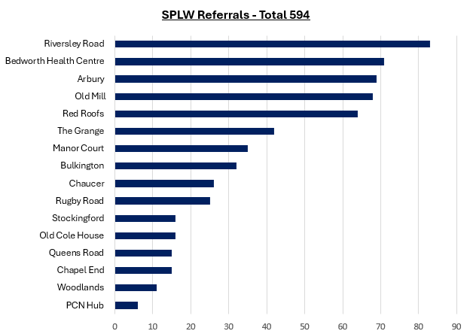
SPLW Referrals Quarter 3 - 2024/2025

Slide 2
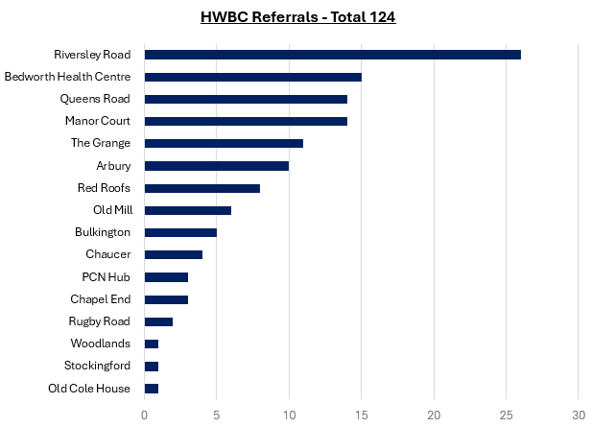
HWBC Referrals Quarter 3 - 2024/2025

Slide 3
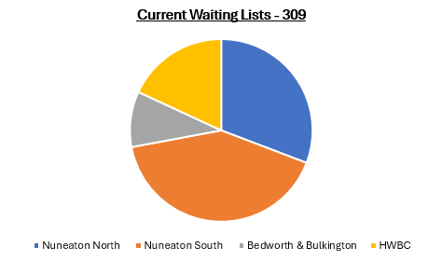

Slide 4
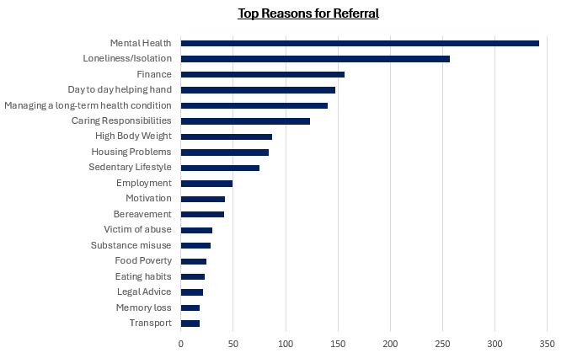
Top Referral Reasons

Slide 5
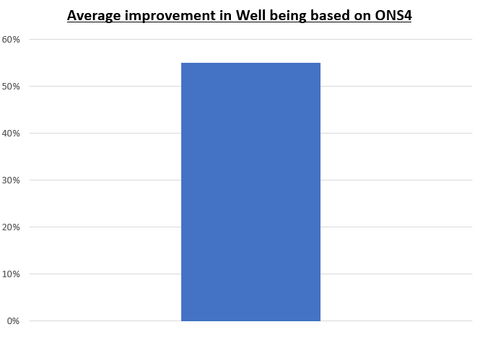
Patient Feedback and ONS4 improvement Scores
"For the first time in my life, I am genuinely happy and looking forward to the future, and it wouldn’t have been possible without you. Walk and Talk sessions gave me something to look forward to and led me to meeting new friends. I will never forget the patience and guidance you showed me when I was too afraid to take it all in. I will be forever grateful to you and your support."
She was grateful for the support. Miss B said that it was great to talk things out. “I think I already knew what I had to do to improve my lifestyle and be happy, I just needed a helping hand along the way to figure it out”.

Slide 6
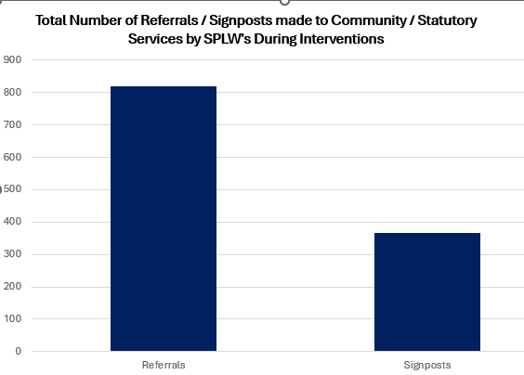
Top 30 Services Referred to by SPLW’s in Quarter 3 - 2024/2025

